Slide 1







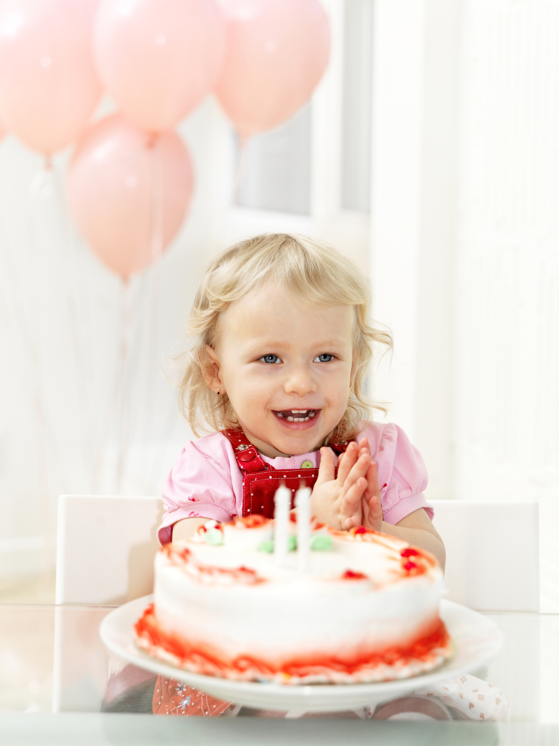







PLEASE JOIN US FOR A
Olivia Wilson
3TH BIRTHDAY PARTY
15
JULY
5 PM
123 Anywhere St.,
Any City, ST 12345

